Slide 1
metabolism
11 Biology
Bremer SHS

Slide 2
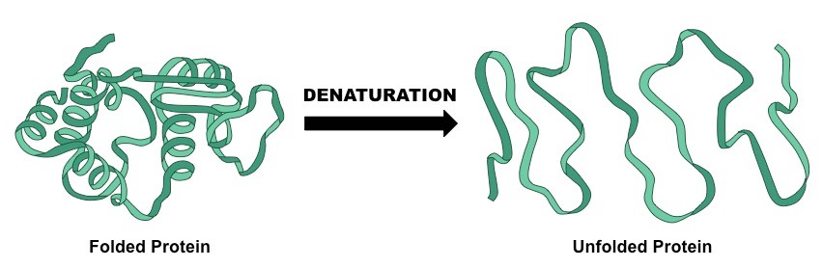
Warm-up Questions
Name the reactants and products in photosynthesis.
Name the reactants and products in cellular respiration.
An enzyme is a protein that helps speed up vital chemical reactions. Describe what happens to the active site of an enzyme (where the substrate molecule binds) when the enzyme is not within optimal conditions and explain how this would affect enzyme activity.

Slide 3
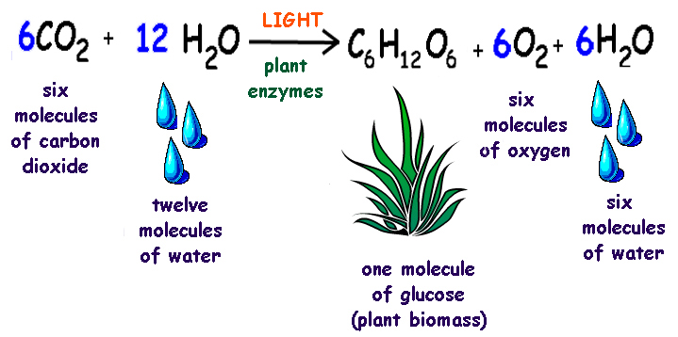
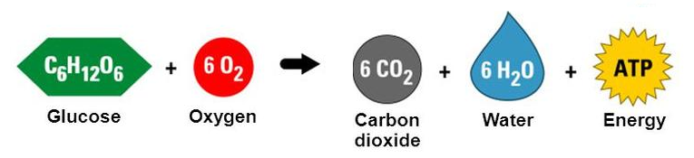
metabolism
Metabolism involves all of the chemical reactions that take place within an organism in order to sustain life.
Most common metabolic pathways that transfer energy through living systems are photosynthesis and cellular respiration.
Metabolism and its life sustaining reactions cannot be maintained without homeostasis.

Slide 4
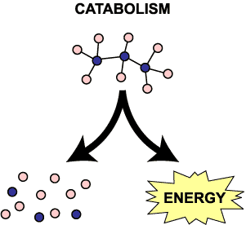
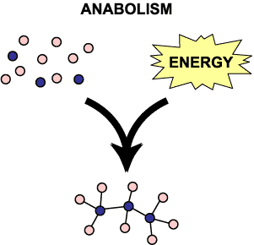
Metabolic reactions
A catabolic reaction occurs when a complex molecule is broken down in to smaller molecules (eg. starch in to glucose).
Catabolic reactions usually break molecular bonds and releases energy (exergonic).
An anabolic reaction occurs when smaller molecules are built up in to larger molecules (eg. amino acids in to proteins).
Anabolic reactions usually make molecular bonds using energy (endergonic).
Cells use the energy released by catabolic reactions to fuel anabolic reactions.

Slide 5
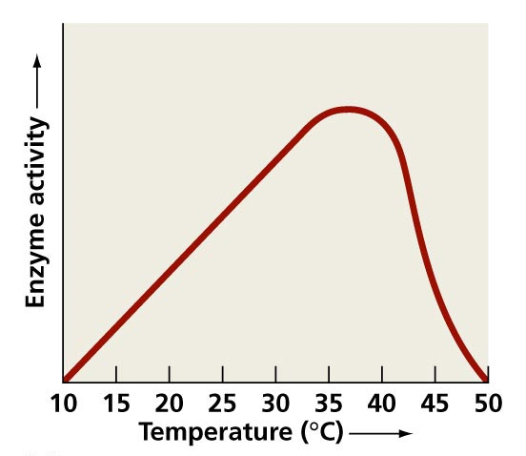
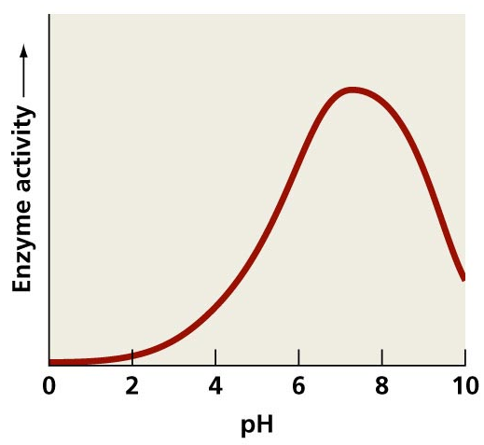
Metabolic conditions
Organisms have a specific tolerance range in which metabolism can take place and homeostasis maintains is responsible for maintaining these conditions.
Most metabolic reactions require help from enzymes.
Conditions outside of the tolerance range for the organism drastically affects the function of an enzyme, reducing the efficiency of life sustaining reactions.

Slide 6
Check for understanding
Identify each of the following as either anabolic or catabolic processes and justify your choice.
Digestion
DNA synthesis
Photosynthesis
Cellular respiration
Carbon dioxide levels increase in the blood as a result of exercise, causing pH levels to decrease. Describe the consequence of an organism going beyond its pH tolerance limit.

Slide 7
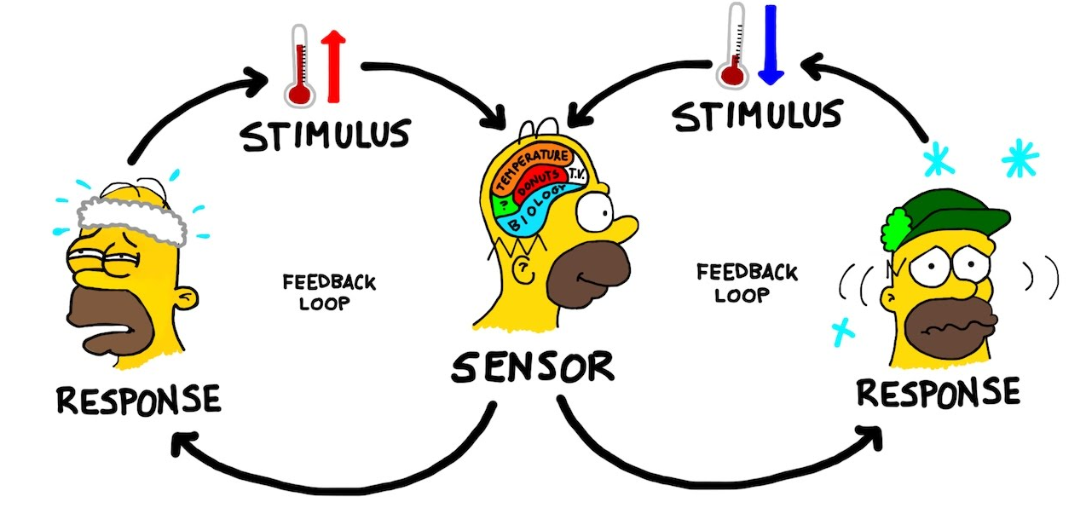
Check for understanding
Complete the following Biozone worksheets:
53 – Control of Blood Glucose
64 – The Homeostatic Role of Blood

